Slide 1
SU2 Overview and Installation
Pointwise® and SU2 Joint Workshop
Sept 29th-30th, 2014
Thomas D. Economon, Francisco Palacios
Aeronautics & Astronautics Department (Stanford University)

Slide 2
What is SU2?
Progress to Date
A new era
getting started

Slide 3
What is SU2?
Progress to date
A new era
getting started

Slide 4
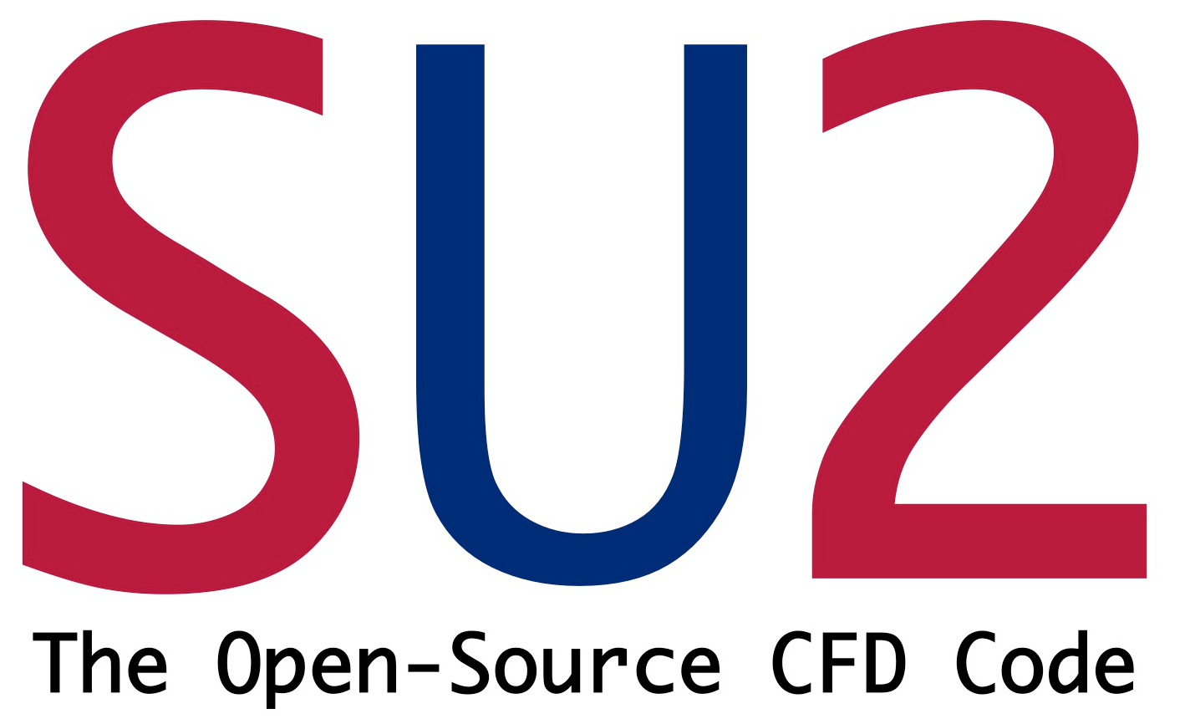
What is SU2?
The SU2 suite is an open-source collection of C++ based software for multi-physics simulation and design (i.e., CFD!).
SU2 is under active development at Stanford University in the Aerospace Design Lab (ADL) of the Department of Aeronautics and Astronautics and now in many places around the world.
http://su2.stanford.edu/
2012 SU² team, "Stanford University Unstructured (SU2): An open-source integrated computational environment for multi-physics simulation and design", AIAA Paper 2013-0287.
2013 SU² team, "Stanford University Unstructured (SU2): Open-source analysis and design technology for turbulent flows", AIAA Paper 2014-0243.

Slide 5
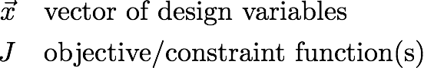
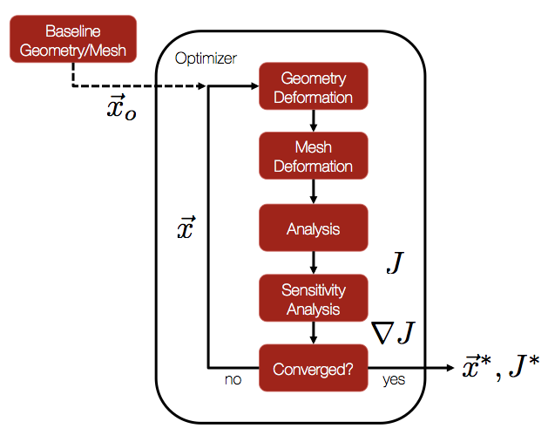
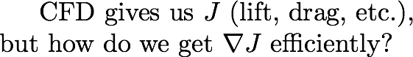
What is SU2?
C++ tools are embedded in a Python framework to automate complex tasks, such as optimal shape design.
Adjoint gradient-based optimization:
Continuous adjoint methodology to achieve cost-independence wrt number of design parameters
Analytic expression for the gradient as a surface integral.
No memory or time overhead compared with the direct solver.

Slide 6
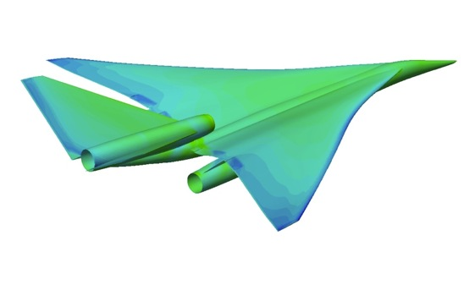
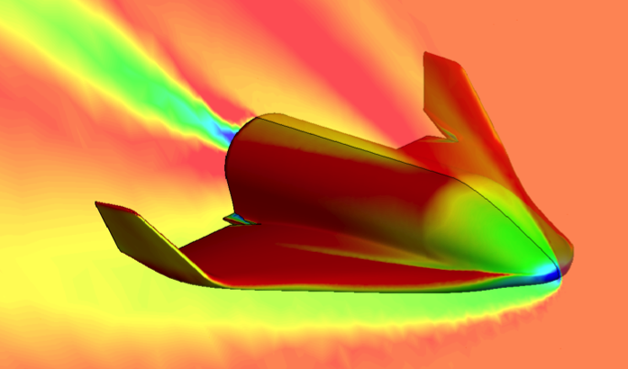
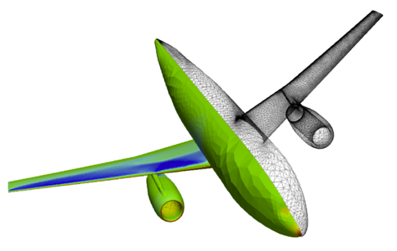
Optimal Shape Design
Our Objective
Computational analysis tools have revolutionized the way we design aerospace systems.
Unfortunately, most established codes are closed, proprietary, unavailable for some potential users, or prohibitively expensive.
The SU2 team looks forward to making CFD analysis and design freely available as open-source software, involving everyone in its creation, enhancement, and rapid development.
NASA N+2 Supersonics Program (2013)
SOAR - S3 Swiss Space Systems (2014)

Slide 7
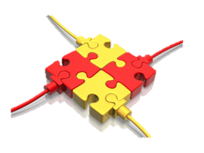
Optimal Shape Design
Why SU2? Software integration in aerodynamic shape design
Integrating existing software packages into coupled multi-physics analysis and design optimization solvers is a challenge.
The variety of approaches chosen for the independent components of the overall problem make it difficult to:
Expand the range of applicability to situations not originally envisioned.
Reduce the overall burden of creating integrated applications.
Exploit fully-coupled approaches.

Slide 8
Optimal Shape Design
Why SU2? Lasting infrastructure for future efforts
An open-source model: basic formulation with a reasonable set of initial capabilities and room for contributions from the community!
Portability: SU2 has been developed using ANSI C++ and only relies on widely-available, well-supported, open-source software.
Reusability and encapsulation: SU2 is built so that the main concepts (geometry, sol. algorithms, num. algorithms, etc.) are abstracted to a very high-level. This abstraction promotes reusability of the code and enables modifications without adversely affecting other portions of the suite.
Flexibility: required to re-purpose existing software for new and different uses. Enabling a common interface for all the necessary components.
Performance: we have attempted to develop numerical solution algorithms that result in high-performance convergence of the solver in SU2. Striving to strike balance between performance and flexibility.
Gradient availability: for many applications it is important to obtain sensitivities of the responses computed by SU2 to variations in design parameters.

Slide 9
Optimal Shape Design
Why SU2? Open-Source Philosophy
We fully endorse the spirit of the open-source movement
We happily support the development efforts in the community
Avoid “starting from scratch” and focus on research
We believe that an open-source code supported by a large group of developers working in concert has tremendous potential…
Technical excellence: draw from expertise all around the world
Open platform encourages collaboration
Increase the pace of innovation in computational science

Slide 10
What is SU2?
Progress to DAte
A new era
getting started

Slide 11
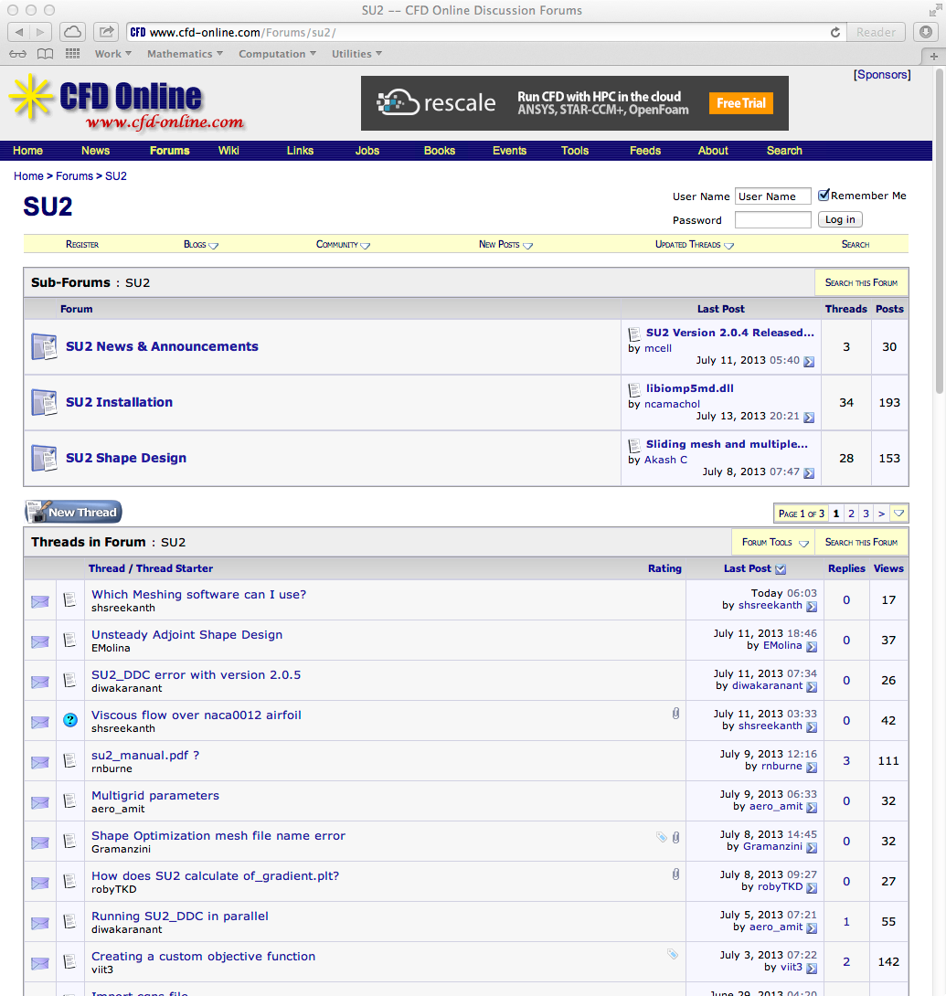
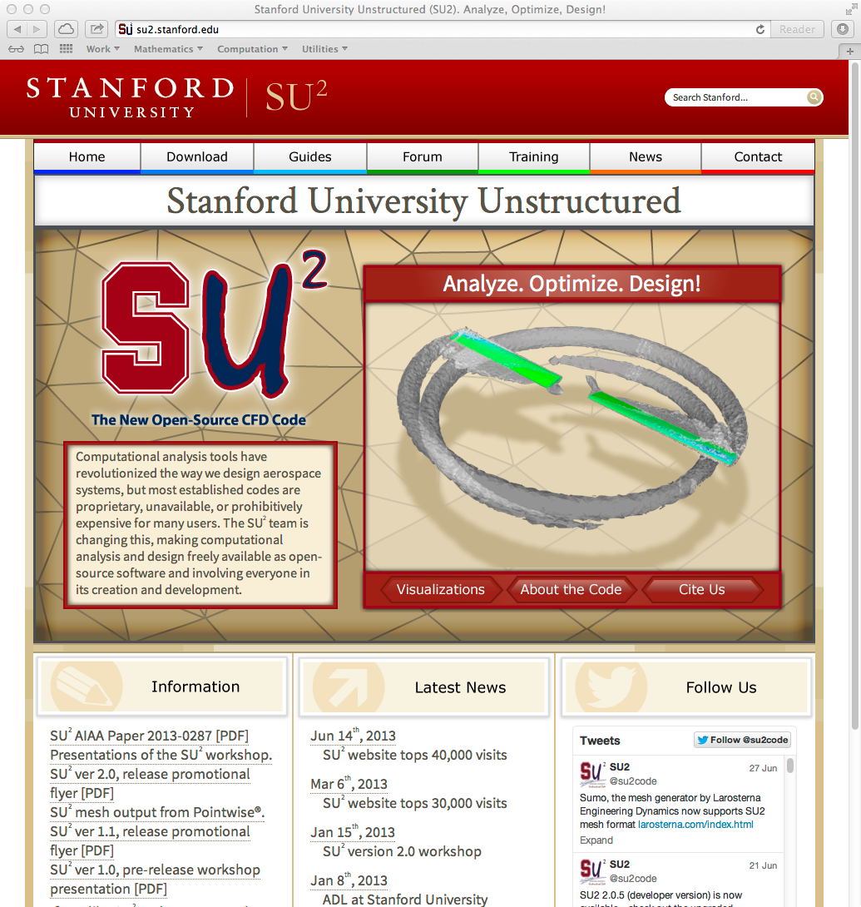
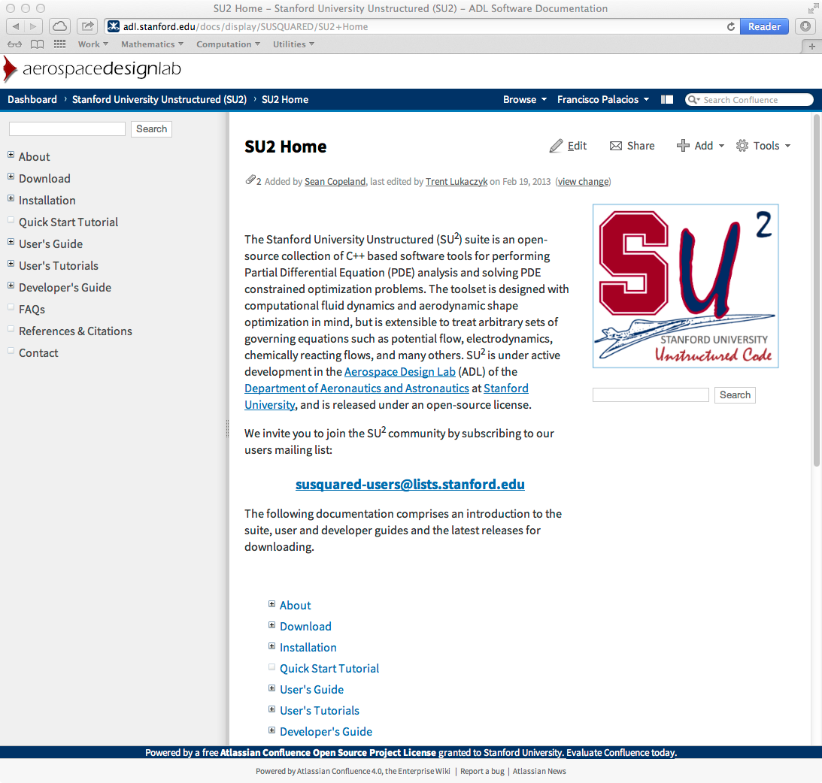
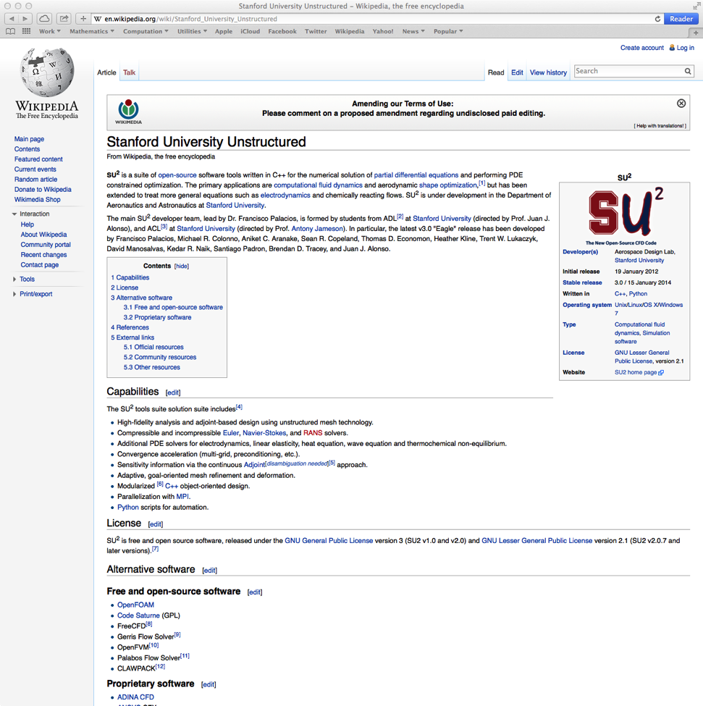
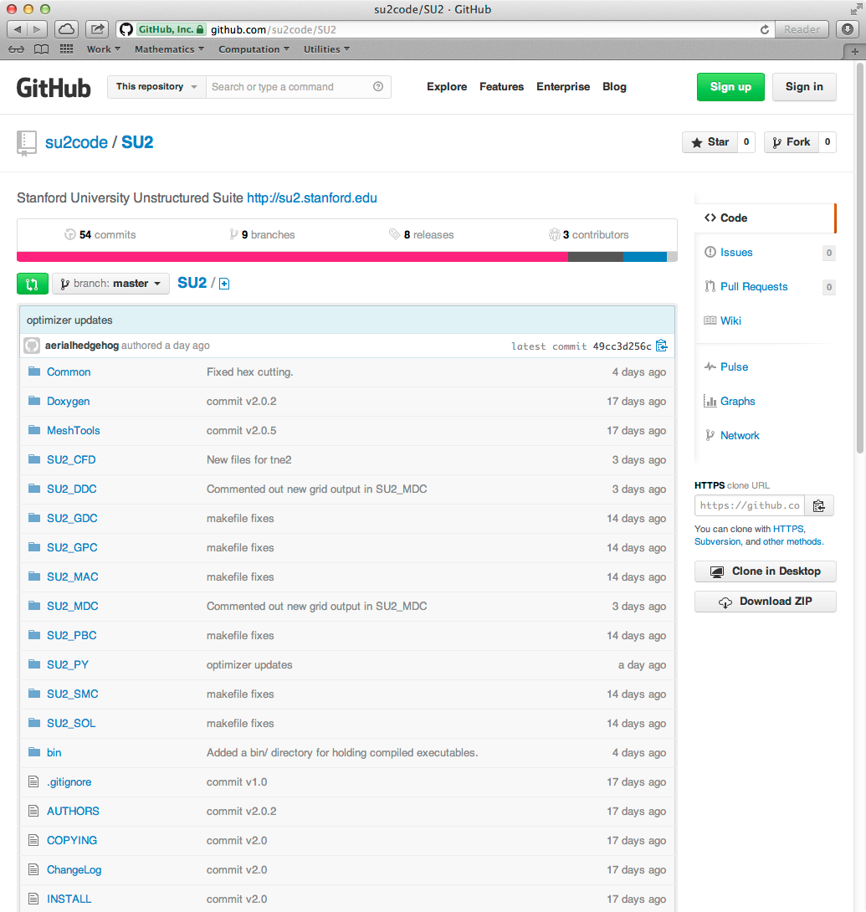
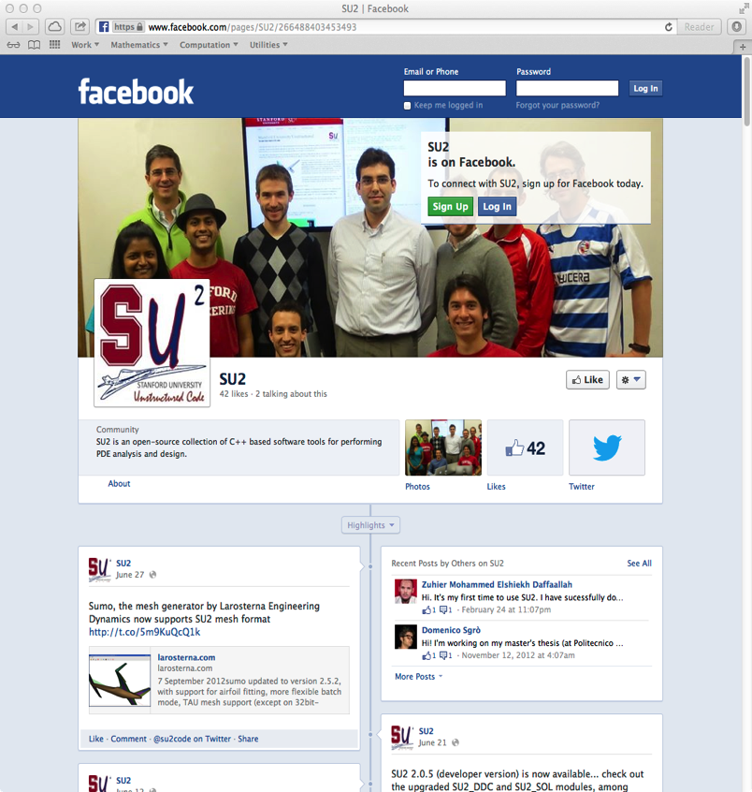
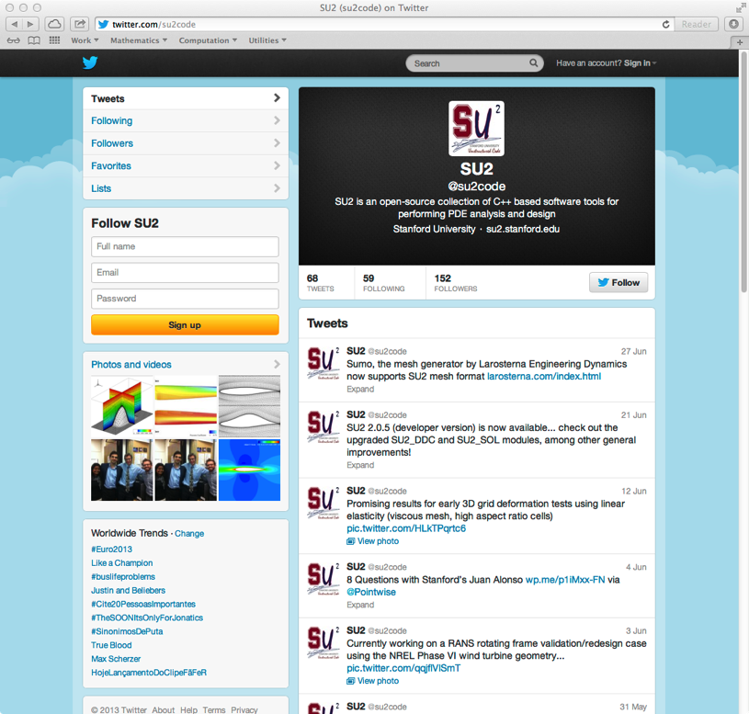
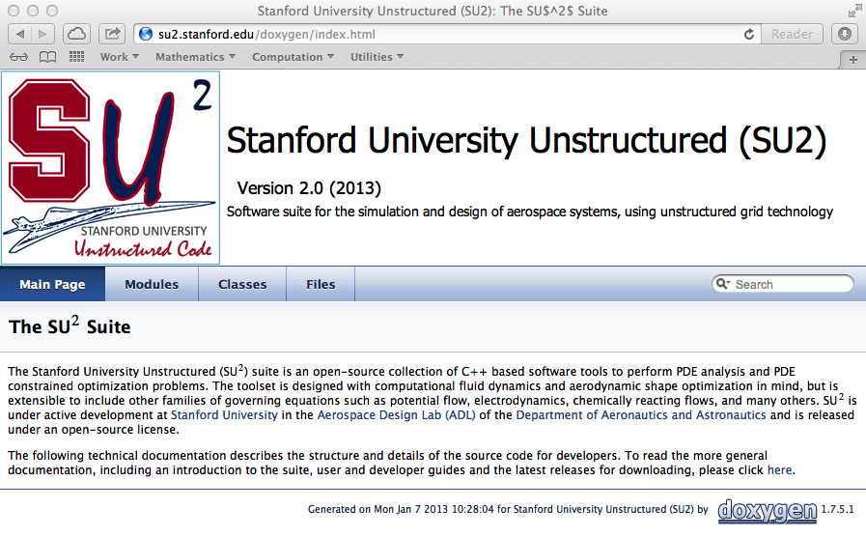
SU2 Infrastructure

Slide 12
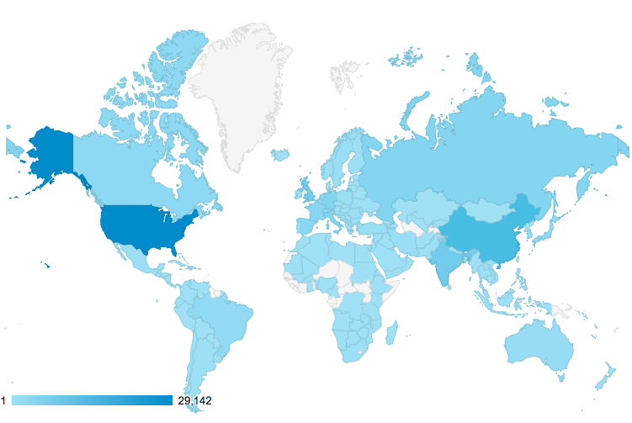
Global Reach
Since release in Jan. 2012: 102,000+ web visits across 160 countries

Slide 13
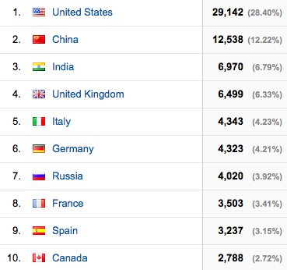
Global Reach
10,000+ downloads, 6,200+ email addresses on the user list

Slide 14
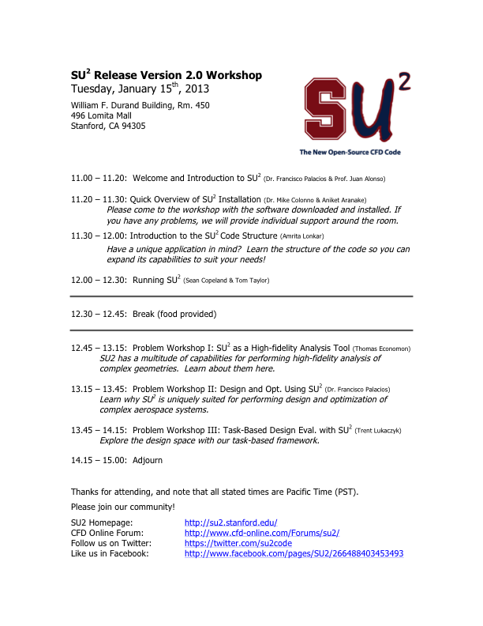
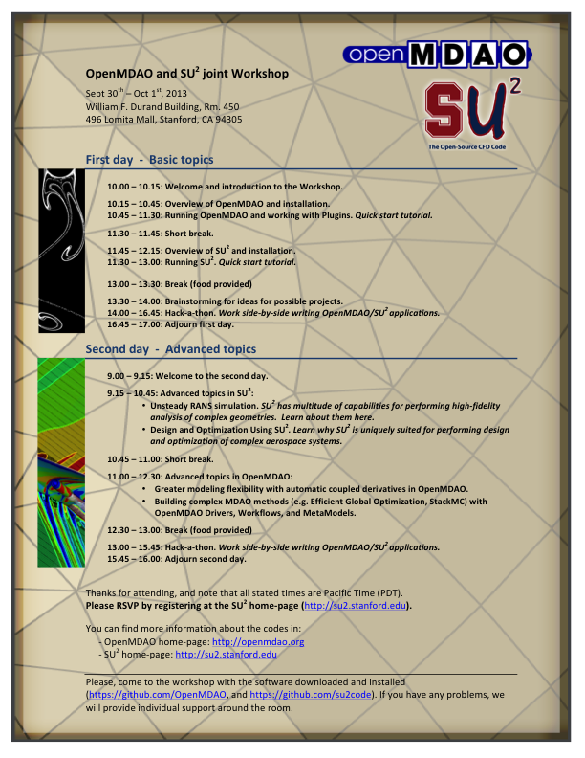
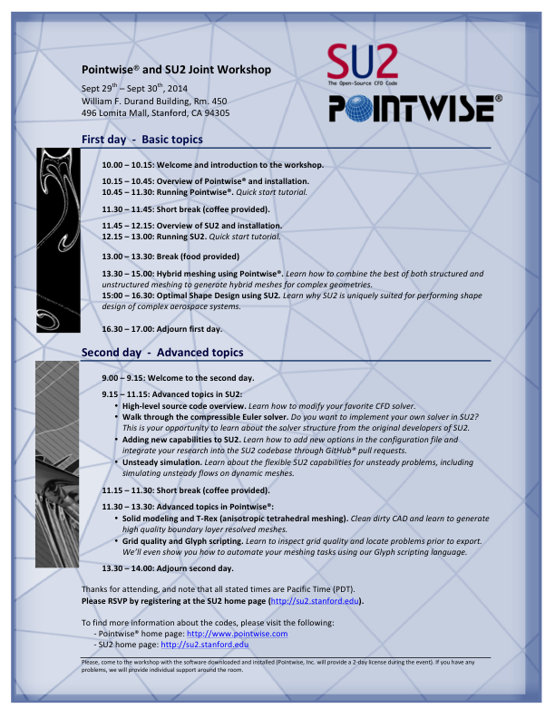
3rd Major Workshop

Slide 15
Optimal Shape Design
Verification & Validation
Verification and Validation is critical. It should address the consistency of the numerical methods, a solid accuracy assessment for different critical application cases, and sensitivity studies with respect to parameters.
Unit/Test problems: zero pressure gradient flat plate boundary layer, bump in a channel, and unsteady flow around a square cylinder.
Subsonic airfoil geometries: NACA 0012 with attached flow, NACA 4412 with a recirculation bubble, and the McDonnell-Douglas 30P30N three-element high-lift configuration.
Subsonic wing and rotorcraft configurations: delta wing at a high angle of attack, and the Caradonna & Tung rotor.
Transonic airfoil geometries: NACA 0012 with attached flow after a shock, RAE 2822 with flow separation.
Transonic wing and full aircraft configurations: ONERA M6, and the DLR F6 model.
2013 SU² team, "Stanford University Unstructured (SU2): Open-source analysis and design technology for turbulent flows", AIAA Paper 2014-0243.

Slide 16
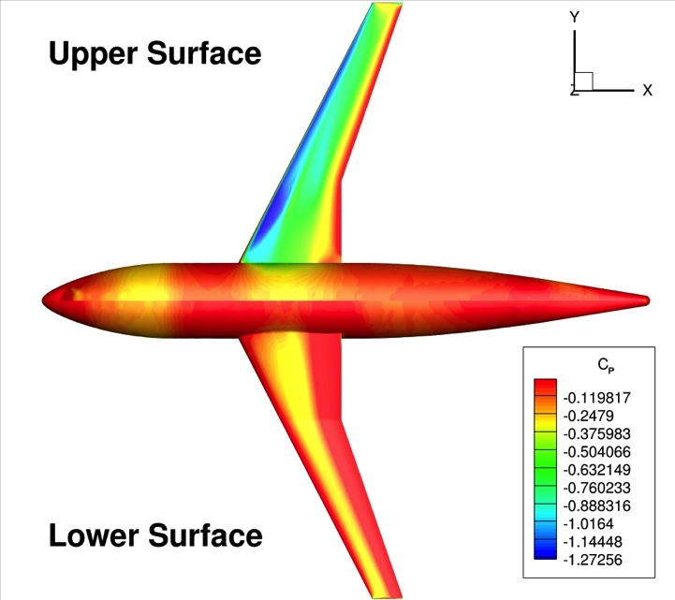
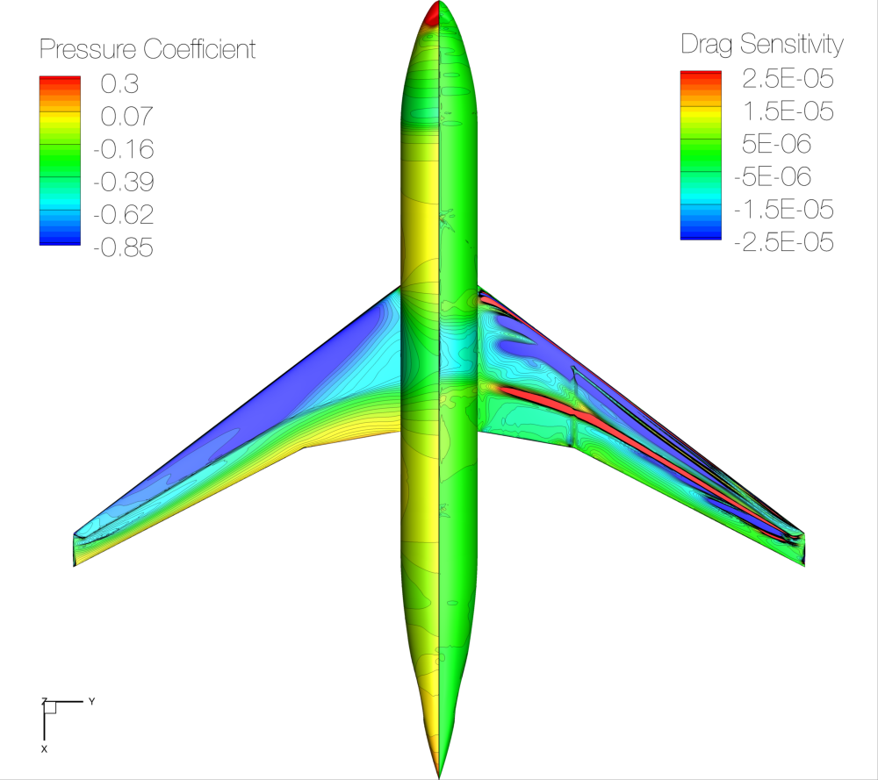
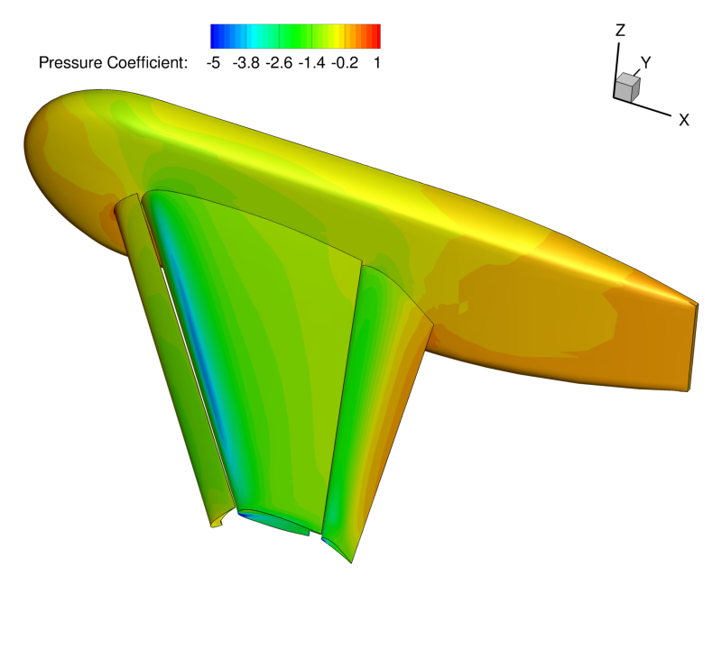
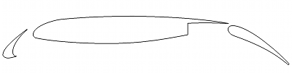
V & V Exercises (RANS)
DLR F6
CRM
Trap Wing
30P30N

Slide 17
Ongoing Collaborations
Pointwise!
Intel Parallel Computing Center: SU2_PHI, improving performance and scalability while retaining flexibility. Porting to advanced Xeon and Phi architectures with high performance? Design in a box?
U. Braunschweig: improving turbulence models
Univ. of Aachen (Prof. Nico Gauger): automatic differentiation for steady and unsteady flow control
Delft University: real gas models
VKI: mutation++ library for non-eq. flows and combustion
NASA: Integration with OpenMDAO, advanced propulsion architectures
Others: supersonics, transition models, UAVs, learning CFD, etc.

Slide 18
What is SU2?
Progress to date
A new era
getting started

Slide 19
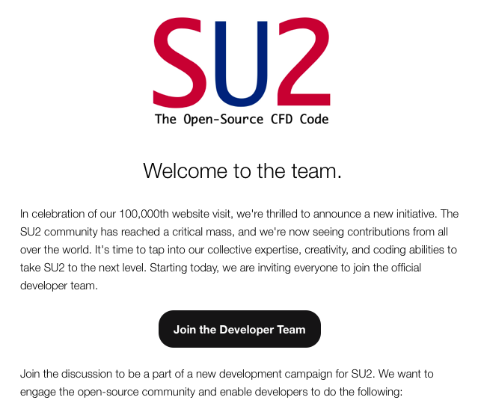
A New Era of Development

Slide 20
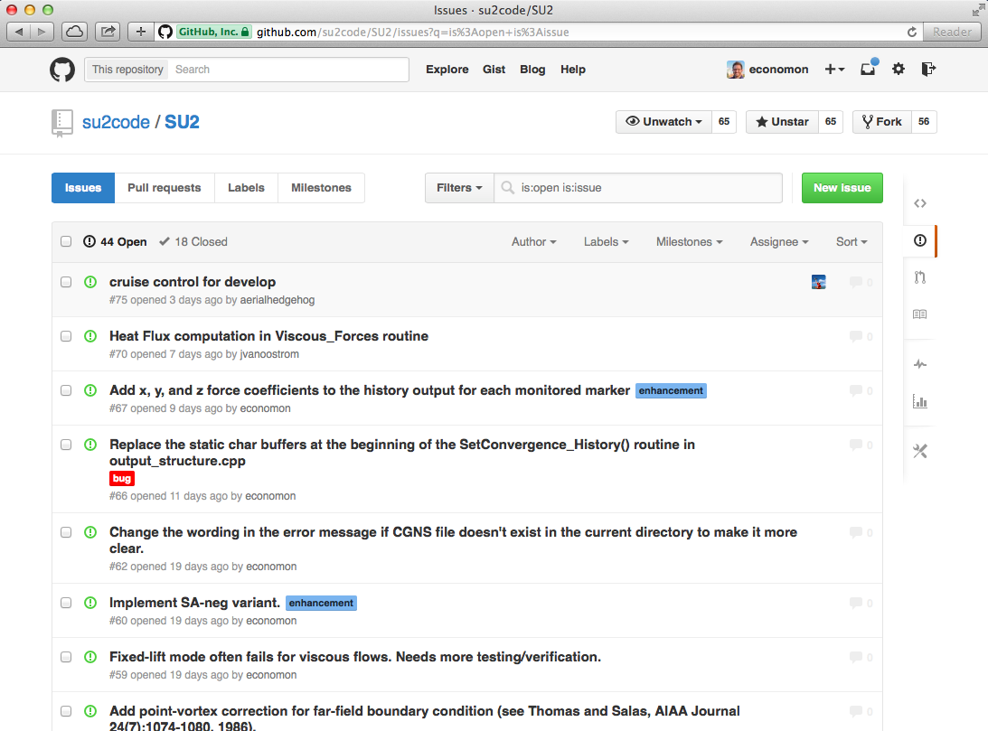
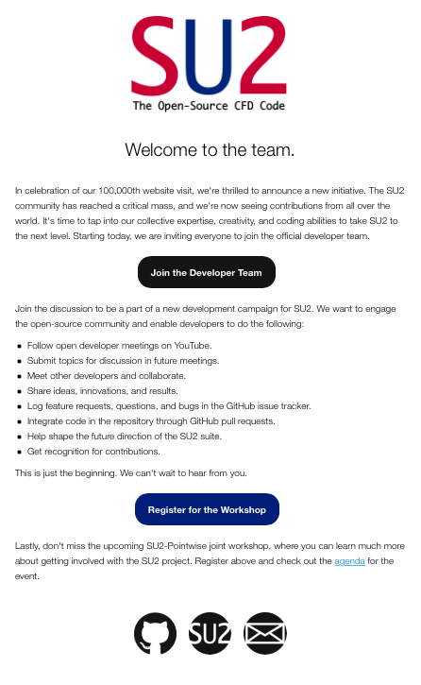
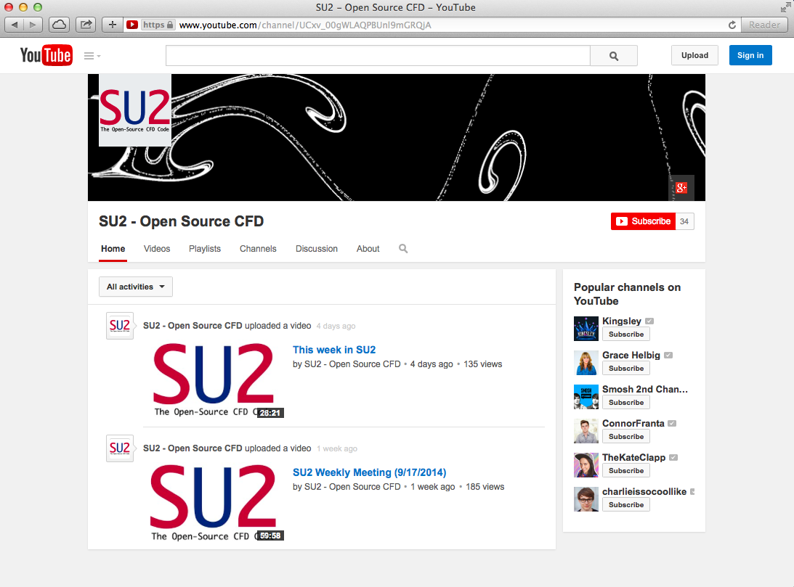
New Initiatives
Join the new dev list, get involved on GitHub, and check out our YouTube broadcasts! Dedicated developer page coming soon.

Slide 21
Flexible Class Structure
1a) Read Input
Class: CConfig
Read the config file.
1b) Read Mesh
Class: CGeometry
Read the mesh file.
Set up multigrid meshes.
2) Solve Equations
Class: CSolution
Euler Equations: CEulerSolution
Plasma Equations: CPlasmaSolution
Euler Adj. Eq.: CEulerAdjSolution
Heat Equations: CHeatSolution
And others…
3) Write Output
Class: COutput
Print on screen
Write solution file
Write restart file
Write history file
Store Flow Variables
Class: CVariable
Stores variables at every mesh node.
Declare & store all flow variables
CEulerVariable: Density, energy etc.
CNSVariable: CEulerVariable + Viscosity
CAdjVariable: Adjoint variables
And others…
Discretization
Class: CNumerics
Spatial Discretization
Convective Flux, Jacobian
CNumerics:: Roe/JST/etc.
Viscous Flux, Jacobian
CNumerics:: Avg_Grad/etc.
Source Terms, Jacobian
CNumerics:: PieceWiseConst.
Temporal Discretization
Implicit Time Integration
Explicit Euler/ Runge-Kutta
Dual Time
Solve Linear System
Class: CSparseMatrix
Linear solvers
BiCSTAB
GMRES
Preconditioners
Linelet
LU-SGS
Low Mach number
Update solution vector

Slide 22
What is SU2?
Progress to date
A new era
getting started

Slide 23
Getting the Code
There are a number of ways to get your hands on SU2:
Register and download from http://su2.stanford.edu/download.html
Download a tagged release from GitHub: https://github.com/su2code/SU2/releases.
Fork the SU2 repository to your account in GitHub and start developing in SU2!
Recommended: Forking is recommended for folks that are interested in developing SU2. Once you have a local copy, you can make changes to the code and submit pull requests to get your work into the official repo. Submit your pull requests to the SU2 develop branch for consideration.

Slide 24
Building SU2 Our Open-Source Build Philosophy
As an open-source code, care has been taken to simplify the build process wherever possible:
Use standard C++
Leverage standard build tools, i.e., autoconf and automake
Avoid or automatically include external dependencies
To build the vanilla version, all you should need is a C++ compiler.
However, we maintain the flexibility to build with additional features:
Fully parallel with MPI, specify your MPI flavor with configure
METIS ships with SU2 and is automatically built for parallel runs
Tecio for binary Tecplot output also ships as an optional feature
CGNS mesh input capability (unstructured, single block)

Slide 25
Building SU2 Simple Build from Source
After getting the code, move into the source directory. $ cd SU2
Run configure to prepare the build. $ ./configure
Make and install the code (installed in /usr/local/bin/ by default) $ make install
Update your PATH variables appropriately before executing. $ export SU2_RUN="/usr/local/bin” $ export SU2_HOME="/home/economon/SU2” $ export PATH=$SU2_RUN:$PATH $ export PYTHONPATH=$SU2_RUN:$PYTHONPATH

Slide 26
Building SU2 Customizing the Build
After getting the code, move into the source directory. $ cd SU2
Specify various options, compilers, etc., and run configure. The following options are typical for high-performance/parallel operation. $ ./configure --with-MPI=mpicxx CXXFLAGS=‘-O3’ --prefix=/home/economon/SU2 --with-CGNS-lib=/home/economon/cgns-3.1.4/lib --with-CGNS-include=/home/economon/cgns-3.1.4/include
Make and install the code (location specified by the prefix option above). Note that this could be done in two separate steps, as “make” and “make install” consecutively at the command line. $ make -j 8 install
Update your PATH variables appropriately before executing. $ export SU2_RUN="/home/economon/SU2/bin” $ export SU2_HOME="/home/economon/SU2” $ export PATH=$SU2_RUN:$PATH $ export PYTHONPATH=$SU2_RUN:$PYTHONPATH

Slide 27
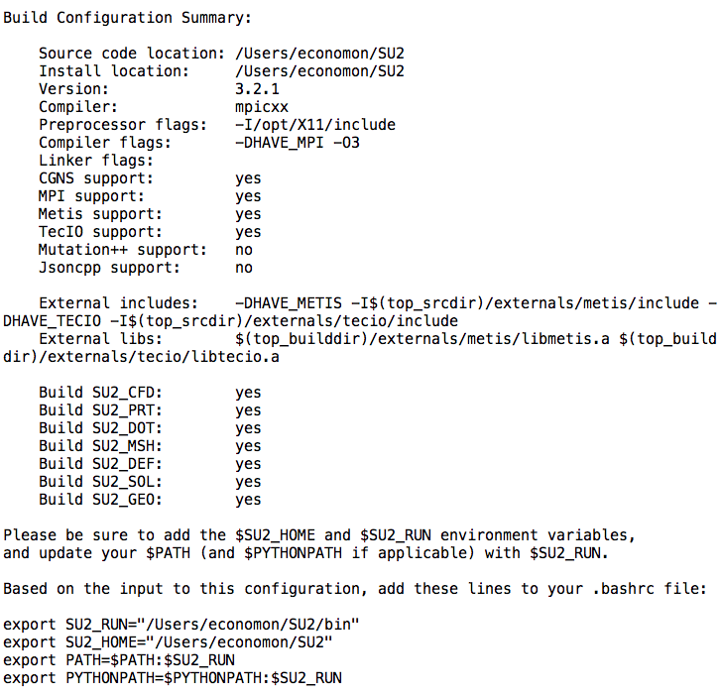
Building SU2 Details in the Configure Output

Slide 28
Building SU2 Tips for Hassle-Free Builds
Recommended: CGNS V3.1.4 without HDF5
Tip: Use parallel make to accelerate the build, i.e., “$ make -j 24 install” to use 24 processes if you have a workstation with 24 cores.
Recommended: For advanced features in SU2, Python scripts are available. Try out the free Python distribution (V2.X distribution) with built-in packages by Enthought: https://www.enthought.com/products/epd/free/

Slide 29
Building SU2 Tips for Hassle-Free Builds
$ alias config_serial="./configure CXXFLAGS='-O3' --prefix=/Users/economon/SU2 --enable-tecio”
$ alias config_mpi="./configure --with-MPI=mpicxx --prefix=/Users/economon/SU2 --enable-tecio CXXFLAGS='-O3’ --with-CGNS-lib=/usr/local/lib --with-CGNS-include=/usr/local/include”
Tip: Add an alias for your configure command and set the environment variables in your ~/.bashrc file (steps 2 and 4 on the previous slide).

Slide 30
Building SU2 Tips for Hassle-Free Builds
$ export SU2_RUN="/home/economon/SU2/bin” $ export SU2_HOME="/home/economon/SU2” $ export PATH=$SU2_RUN:$PATH $ export PYTHONPATH=$SU2_RUN:$PYTHONPATH
Tip: Note the order of the PATH variable. $SU2_RUN appears before $PATH in this case. If $PATH comes before $SU2_RUN, make sure that there are not any previous versions of SU2 installed in other locations in your PATH, otherwise it may use old versions and cause headaches…

Slide 31
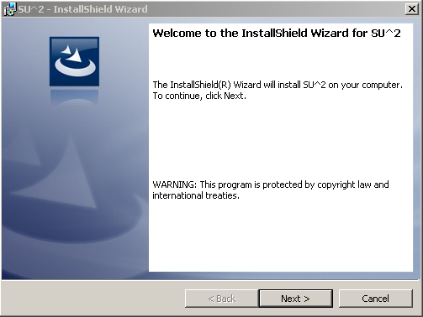
Windows Installation
Download installer and follow wizard instructions
Installer will place files in the correct locations
Default install location: C:\SU2
Command line syntax remains the same
Recommended: Set your WINDOWS PATH after install
Required: For parallel version, you must install and configure Microsoft HPC Pack (or just Microsoft MPI) before installing SU2.

